Slide 1
Fundamentals of Accelerated Data Science
NVIDIA

Slide 2
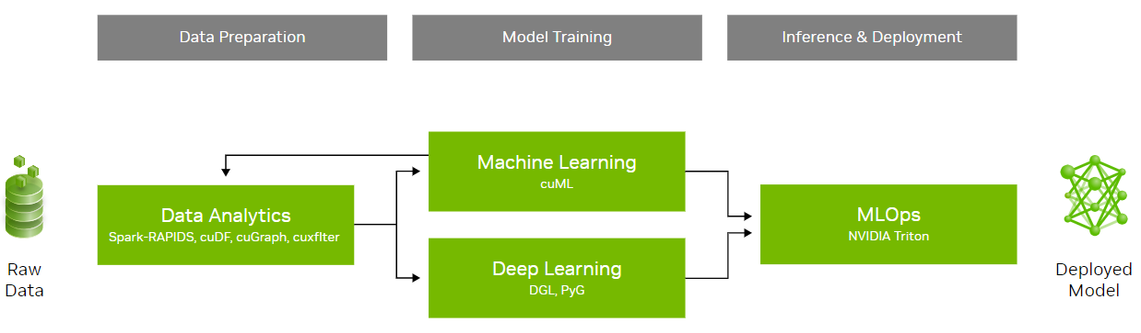
Workshop Overview
An introduction to data science with a focus on speed and efficiency
Learning objectives:
Understand the fundamental concepts of data science and parallel computing
Explore practical examples of accelerated data science pipelines
Examine the methods used to achieve acceleration in data science and discuss their broader implications
This workshop will not cover statistical analysis, neural networks, and distributed computing
 | Workshop Outline
Task 1 | Data science overview Data manipulation
Task 2 | Graph analytics
Task 3 | Machine Learning
Coding Assessment | Biodefense

Slide 3
Section 3 Agenda
• | Machine Learning Fundamentals
• | End-To-End Machine Learning
• | Accelerating Machine Learning
• | Hands-On Lab

Slide 4

Machine Learning
Data, algorithm, and compute
Data science has a broader focus that encompasses various techniques for extracting insights and meaning from data, including statistical analysis and data visualization. In contrast, machine learning primarily focuses on building algorithms that enable computers to learn from data and make predictions.
Pillars of machine learning:

Slide 5
Traditional Programming: Rules-Based
Explicitly define rules and logic to follow
Rules-based
Training
Inference
rules
input
output
input
learning algorithm
model
output
new input
model
prediction
new input
prediction
new input
prediction

Slide 6
Model Training
Models learn patterns from data to make predictions or decisions without explicit programming
Rules-based
Training
Inference
rules
input
output
input
learning algorithm
model
output
new input
model
prediction
new input
prediction
new input
prediction

Slide 7
Supervised vs. Unsupervised
Trained on labeled data to make predictions or classifications on new, unseen data
Rules-based
Training
Supervised Regression: predicting a continuous value Classification: predicting a discrete label
rules
input
output
input
learning algorithm
model
output

Slide 8
Supervised vs. Unsupervised
Identifying unknown patterns and structures in data without predefined categories
Rules-based
Training
Supervised Regression: predicting a continuous value Classification: predicting a discrete label | Unsupervised Clustering: grouping data points together Dimensionality reduction while retaining information
rules
input
output
input
learning algorithm
model
X
output

Slide 9
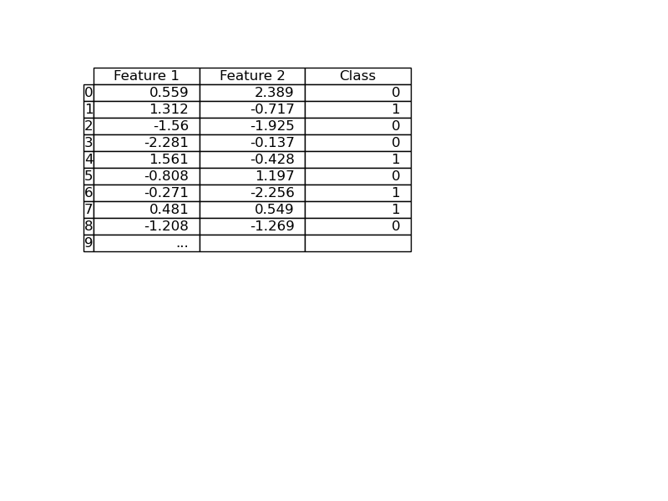
Example Dataset
Multiple machine learning tasks can be applicable to the same dataset
Features
Target

Slide 10
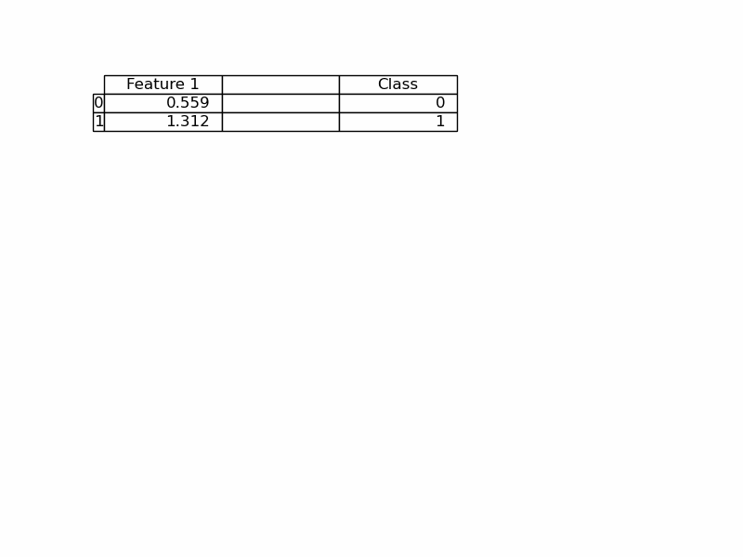
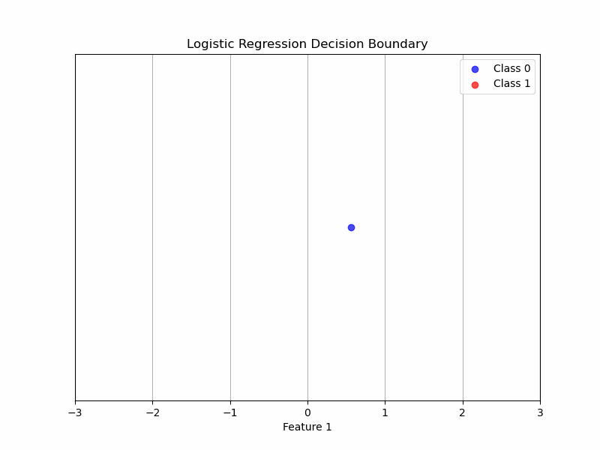
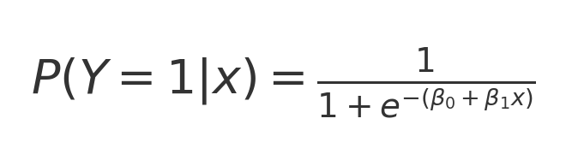
Example Dataset
Classification assigns data to known categories

Slide 11
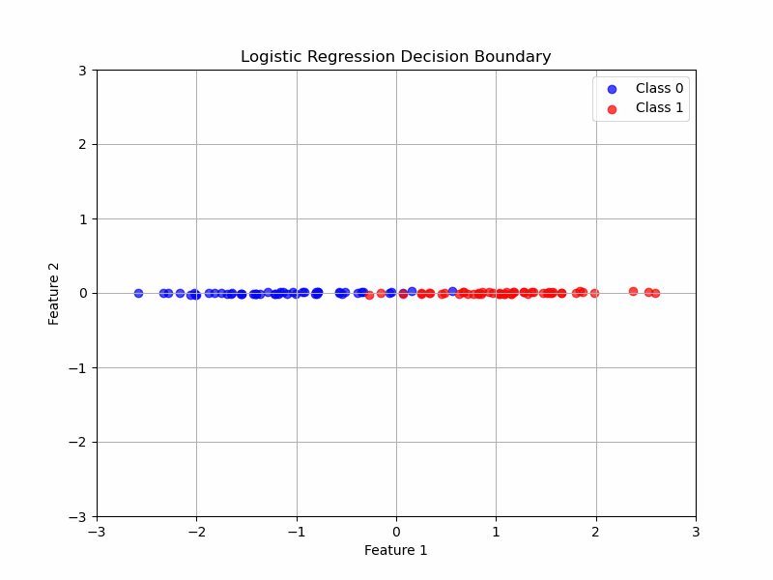
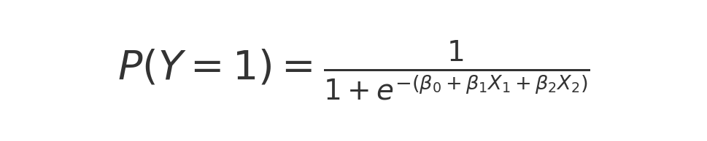
Example Dataset
Classification assigns data to known categories

Slide 12
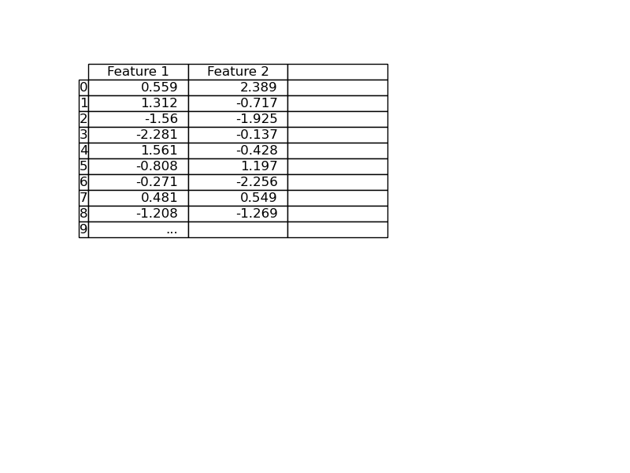
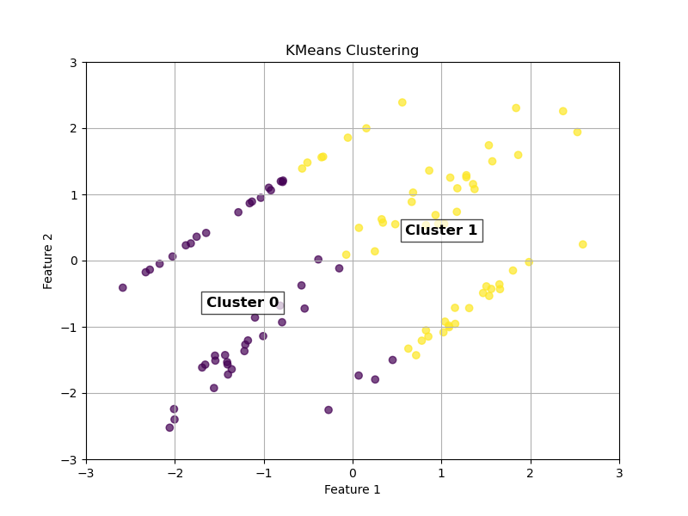
Example Dataset
Clustering discovers inherent groups in data without prior labeling

Slide 13
Inference
Process incoming data and producing results based on patterns learned during training
Rules-based
Training
Inference
rules
input
output
input
learning algorithm
model
output
new input
model
prediction
new input
prediction
new input
prediction

Slide 14
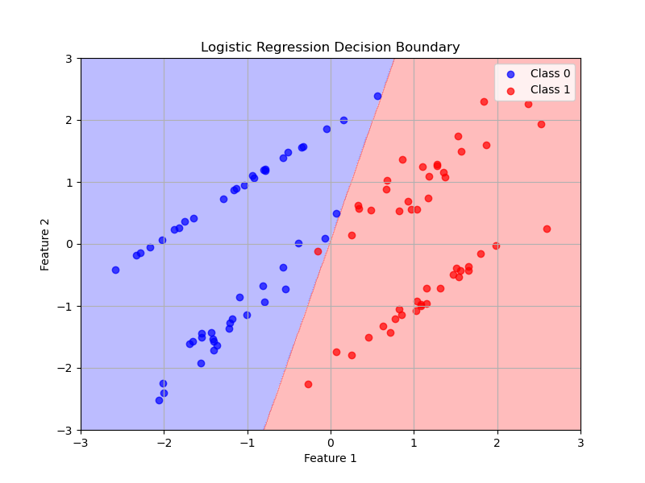
Example Dataset
Process incoming data and producing results based on patterns learned during training

Slide 15

Lifelong Learning
Allows models to update and improve their performance as new data becomes available
 | Continuous Learning Compare predictions with actual results to identify data drift Update model (retrain) with new data Enables systems to automatically improve their performance through experience, making it a powerful tool for data-driven decision-making and automation across various domains
Training
Inference
input
learning algorithm
model
output
new input
model
prediction
new input
prediction
new input
prediction

Slide 16
Common Use Cases
Benefits:
Problem solving: excels at complex problems where patterns are not easily discernible
Adaptability: models can adapt to new data, new tasks, and improve over time with retraining
 | Supervised | Unsupervised
Online Services | Spam / Not Spam Predict Probability Customer Will Click on Ad | Group Articles into Categories Similar Search Results
Financial Services | Credit Card Fraud | Anomaly Detection
Telecom | Predict Customer Churn
Health Care | Probability of Readmission Predict Days of Hospital Stay | Patient Similarity
Real Estate | Predict House Price
Retail | Prejudice Price Forecast Sales Sentiment Analysis | Similar Customers Product Similarity Customer Group Products Which Are Purchased Together

Slide 17
Machine Learning Model Development Workflow
Systematic process of developing, training, evaluating, and deploying machine learning models
Data Preparation
Feature Engineering
Model Selection Model Training
Model Evaluation
Model Deployment
Define the business problem and project objectives
Gather data from relevant sources
Format data for model consumption
Assess the model’s performance using various metrics
Exploratory data analysis (ET)
Clean, transform, and prepare data for analysis
Choose appropriate algorithms based on the problem and data
Integrate the model into production systems
Continuously monitor the model’s performance and retrain as needed

Slide 18
Machine Learning Model Development Workflow
Systematic process of developing, training, evaluating, and deploying machine learning models
Data Preparation
Feature Engineering
Model Selection Model Training
Model Evaluation
Model Deployment
Data preparation – clean, transform, and prepare the data
Feature engineering is often considered one of the most crucial and impactful steps in the machine learning process to improve a model's predictive power and ability to generalize to new data
  Transforms raw data into a format that better represents the underlying problem, making it easier for algorithms to learn patterns and make predictions
  Feature engineering is an iterative process that allows for continuous refinement and improvement of model inputs
Use cuDF to create features for downstream ML tasks:
cuML
XGBoost
cuDNN

Slide 19

Machine Learning Model Development Workflow
Systematic process of developing, training, evaluating, and deploying machine learning models
Data Preparation
Feature Engineering
Model Selection Model Training
Model Evaluation
Model Deployment
Model selection – choosing the appropriate algorithm and configuration(s)
Model training – fitting the model to the dataset
  Faster runtime shortens development time and improves productivity
Task | Goal |  | Algorithm / Model
Classification | Assign input data to predefined categories or labels |  | Logistic Regression, Decision Trees, Random Forest, SVM, KNN, Naïve Bayes, Neural Networks
Regression | Predict continuous numerical values based on input features |  | Linear Regression, Ridge & Lasso Regression, Decision Trees, Random Forest, SVR, Neural Networks, XGBoost
Clustering | Group similar data points together without predefined labels |  | k-Means, Hierarchical Clustering, DBSCAN, Gaussian Mixture Models (GMM), Mean Shift
Decomposition & Dimensionality Reduction | Reduce the number of input features while preserving important information |  | PCA, SVD, t-SNE, UMAP, Autoencoders

Slide 20
Classification
Categorize input data into predefined classes
 | K-Nearest Neighbors | Logistic Regression |  | Decision Tree
Approach | KNN makes predictions based on the similarity of new data points to known examples in the training set. The algorithm calculates the distance between the new point and all points in the training set. It identifies the K nearest neighbors and uses majority voting among the K neighbors | Logistic regression is a statistical method used for binary classification. It predicts the probability of an instance belonging to a particular class, using the logistic function (sigmoid) to map predictions to probabilities between 0 and 1 |  | Creates a tree-like model of decisions based on features in the data. From the root node, it splits the data into subsets based on the most significant attributes. The splitting criteria is determined by maximizing information gain or minimizing impurity
Pros | Makes no assumption about data distribution “Lazy” learning algorithm Adapts quickly to new data | Generally efficient Less prone to overfitting |  | Does not require feature scaling Robust to outliers Can handle categorical variables Makes no assumption about data distribution
Cons | Prone to overfitting Sensitive to outliers Requires feature scaling High computational cost for large datasets, especially during prediction High memory requirement (needs to store the entire training dataset) | Sensitive to outliers Assumes linear relationship between features and log-odds of outcome Suitable for binary outcome Assumes no correlation between features Requires irrelevant features to be excluded Can overfit on high-dimensional datasets |  | Prone to overfitting Computationally expensive for large datasets

Slide 21
Decision Tree
Decision trees are prone to overfitting
Recursively splitting the data based on features to create a tree-like structure
Select the best feature to split the data to increase the purity of the resulting subsets with respect to the target variable
Challenges:
Prone to overfitting
Solution:
Pruning
Ensemble
root node
Purity Improvement
leaf node

Slide 22
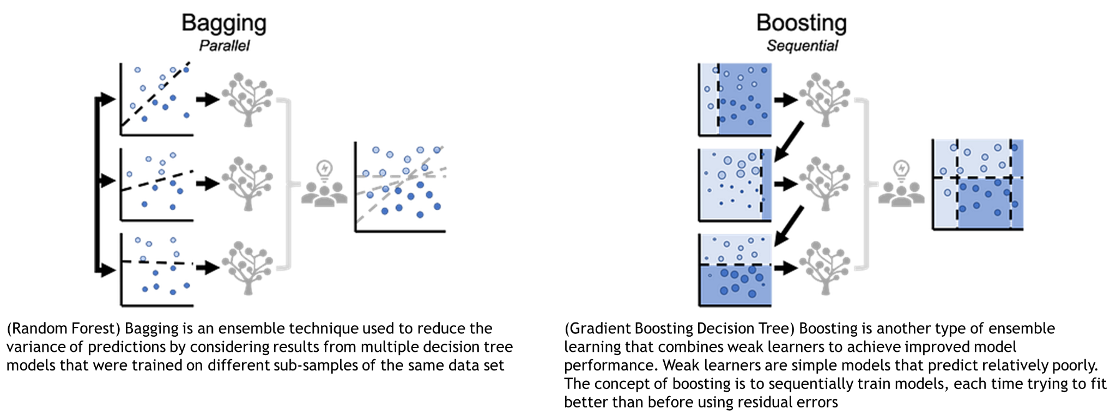
Ensemble
Using multiple decision trees

Slide 23
Ensemble
Using multiple decision trees

Slide 24
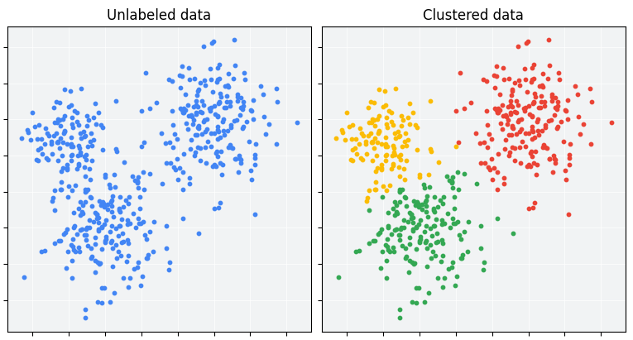
Clustering
Group unlabeled examples based on their similarity to each other
 | K-Means | DBSCAN
Approach | Partitions data by iteratively moving cluster centers and re-assigning data points based on which center is closest to the point | Uses spatial density to cluster—finds cluster points within at most epsilon distance of another point in the cluster
Pros | Fast, simple, and easy to understand Scalable to large datasets | Can identify clusters of any arbitrary shapes Automatically determines the number of clusters Robust to outliers
Cons | Assumes spherical clusters Requires specifying the number of clusters in advance Sensitive to outliers | Less efficient for very large datasets Requires specifying minimum points and maximum neighborhood distance
Use cases:
Market segmentation
Anomaly detection
Data Imputation

Slide 25
Machine Learning Model Development Workflow
Systematic process of developing, training, evaluating, and deploying machine learning models
Data Preparation
Feature Engineering
Model Selection Model Training
Model Evaluation
Model Deployment
Model evaluation – assessing the quality and performance of a trained machine learning model using various metrics
  Balance accuracy and inference speed
  Maximize throughput given an application’s accuracy requirement and latency budget
Evaluation metrics:
Accuracy
  Underfit vs overfit
  Cross validation is a resampling method to protect against overfitting
Latency and throughput
  Evaluate how well the inference performance scales with increasing data volumes or concurrent requests
  Ensure that optimizations for speed don't significantly degrade the model's accuracy or performance on its intended task

Slide 26
Machine Learning Model Development Workflow
Systematic process of developing, training, evaluating, and deploying machine learning models
Data Preparation
Feature Engineering
Model Selection Model Training
Model Evaluation
Model Deployment
Model tuning
  Feature selection finds the optimal subset of features
  Hyperparameter tuning using techniques such as grid search
Use cuML to accelerate machine learning model training
Low data processing cycle time translates to higher productivity, more experimentation, and improved model performance

Slide 27
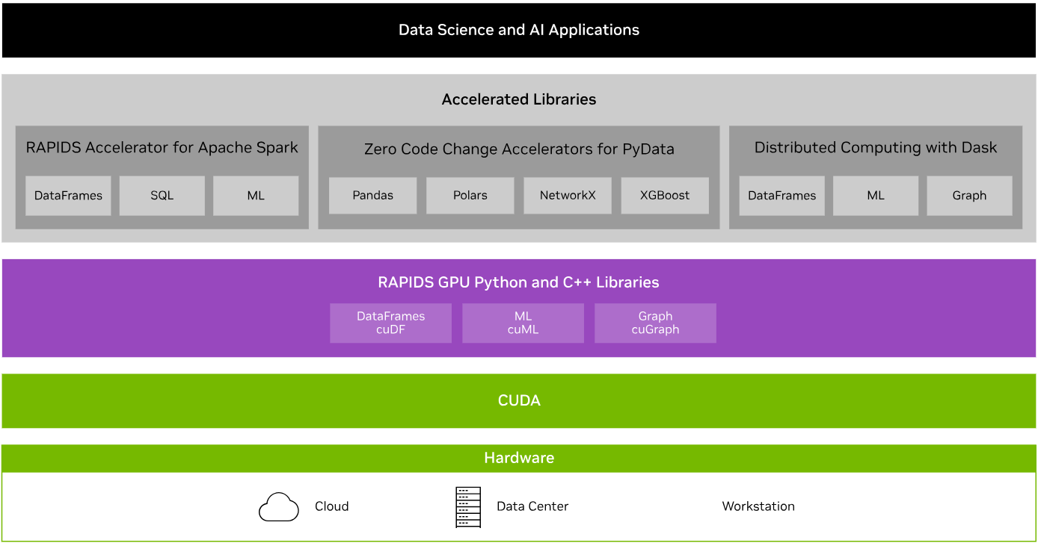

RAPIDS Transforms Data Science
An optimized hardware-to-software stack for the entire data science pipeline

Slide 28

XGBoost + RAPIDS
Optimized gradient boosting machine learning algorithm
Extreme Gradient Boosting, is a scalable, distributed gradient-boosted decision tree machine learning algorithm
Gold standard in single model performance for classification and regression
  Delivers excellent accuracy and efficiency
  Handles large datasets effectively through multi-threading
  Handles imbalanced datasets and outliers
  Uses regularization to prevent overfitting and improve model generalization
RAPIDS was built from the start to integrate with this amazing algorithm, including seamless GPU-acceleration such as loading data from cuDF DataFrames and cuPy arrays - this significantly speeds up model training and improves accuracy for better predictions

Slide 29
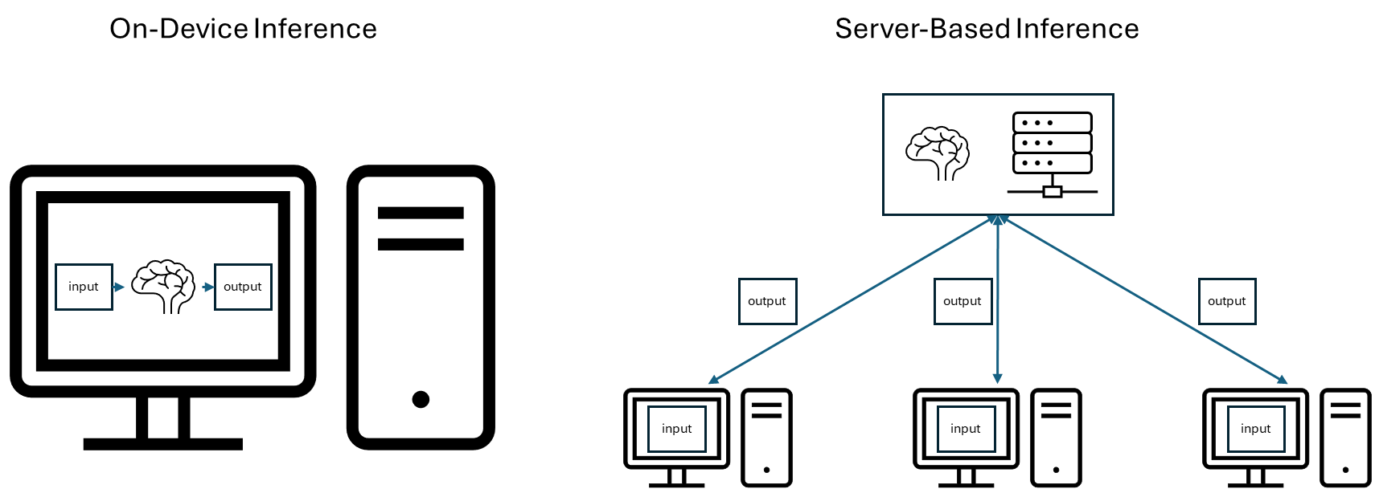
Machine Learning Model Development Workflow
Systematic process of developing, training, evaluating, and deploying machine learning models
Data Preparation
Feature Engineering
Model Selection Model Training
Model Evaluation
Model Deployment

Slide 30
Machine Learning Model Development Workflow
Systematic process of developing, training, evaluating, and deploying machine learning models
Data Preparation
Feature Engineering
Model Selection Model Training
Model Evaluation
Model Deployment

Slide 31
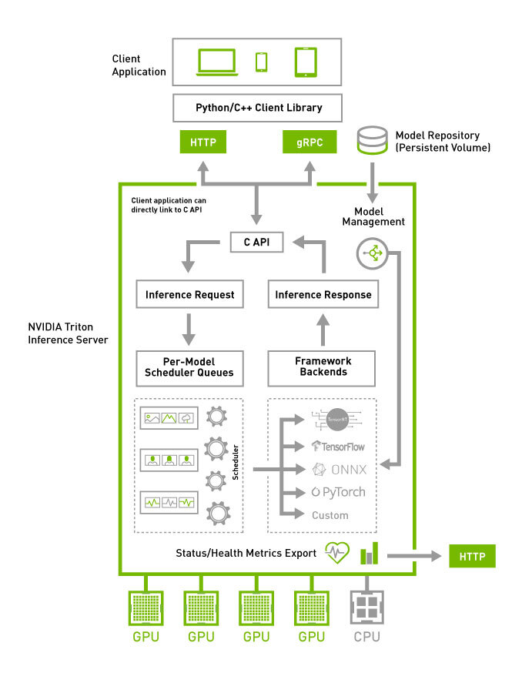
Triton Inference Server
Open-source inference serving software that is designed for deploying AI models at scale
Key Features:
Multi-framework support (TensorFlow, PyTorch, ONNX, etc.)
Concurrent model execution
Dynamic batching for improved performance
Model versioning and ensembling
Benefits for Data Scientists:
Simplifies model deployment in production environments
Enables efficient scaling of machine learning models
Provides a consistent interface across different ML frameworks
Optimizing Performance:
Performance analyzer
Model analyzer

Slide 32
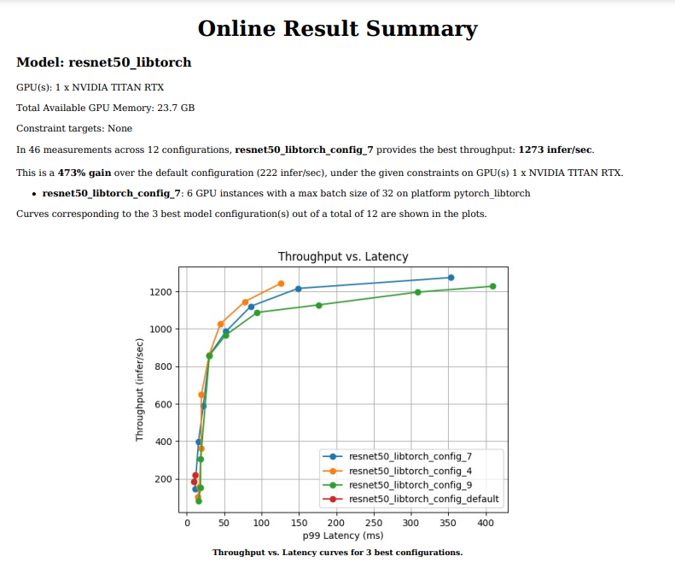
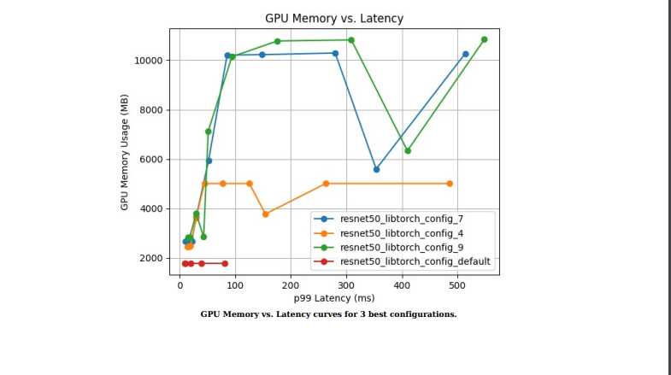
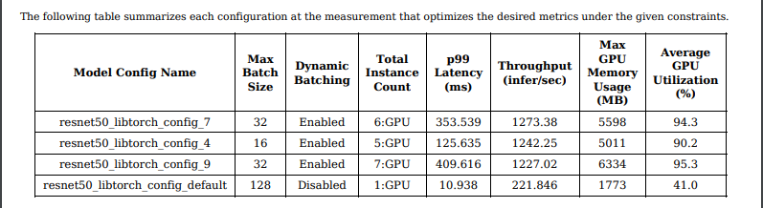
Example of Model Analyzer Report

Slide 33
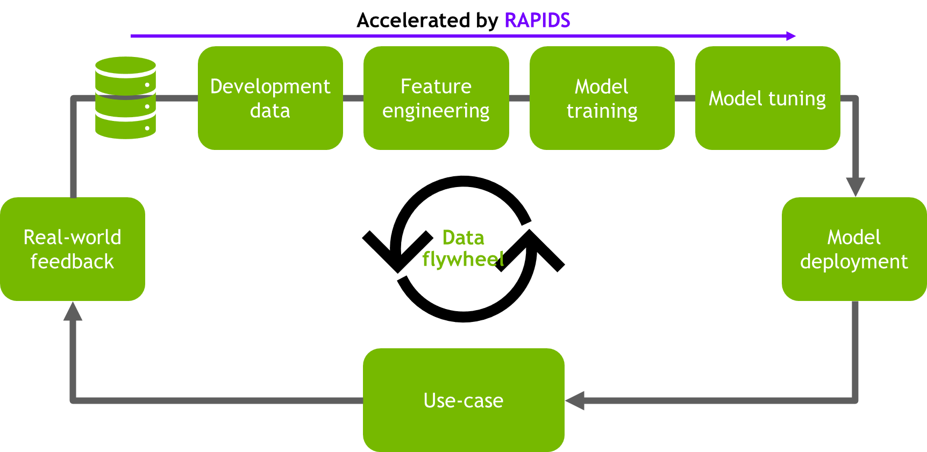
Machine Learning Model Development Workflow
Systematic process of developing, training, evaluating, and deploying machine learning models
Data Preparation
Feature Engineering
Model Selection Model Training
Model Evaluation
Model Deployment
Efficient data processing on large datasets leads to better results
  Facilitates higher data quality and quantity that directly impact model performance
  Increases productivity
  Enables more experimentation for model tuning
  Fosters innovation and progress
  Reduces time to insight and total cost of ownership
Seamlessly integrate with existing workflows through plugins
Optimal model deployment that balances performance and resource allocation
cuDF
cuML + XGBoost
Triton

Slide 34
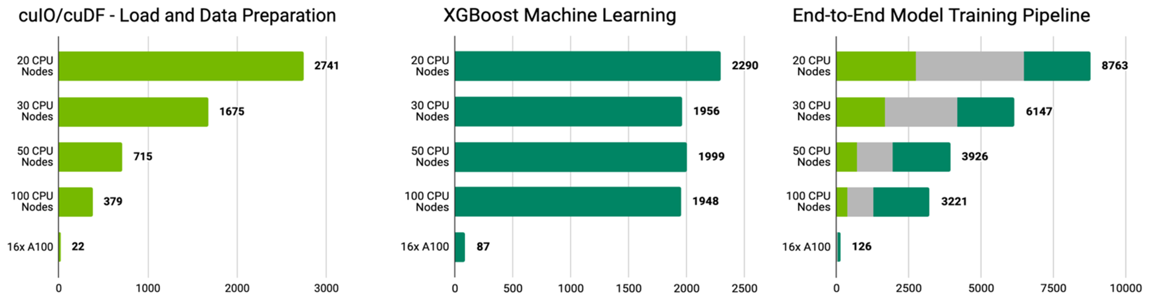
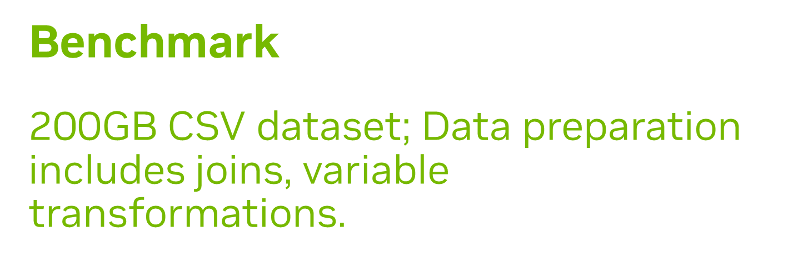
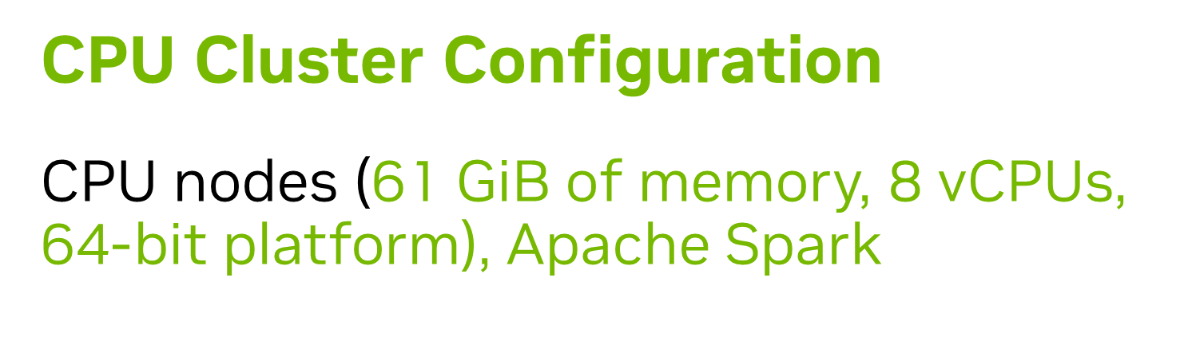

Proven Faster for Data Science
Realize efficiency and scalability with multi-GPU for massive datasets

Slide 35
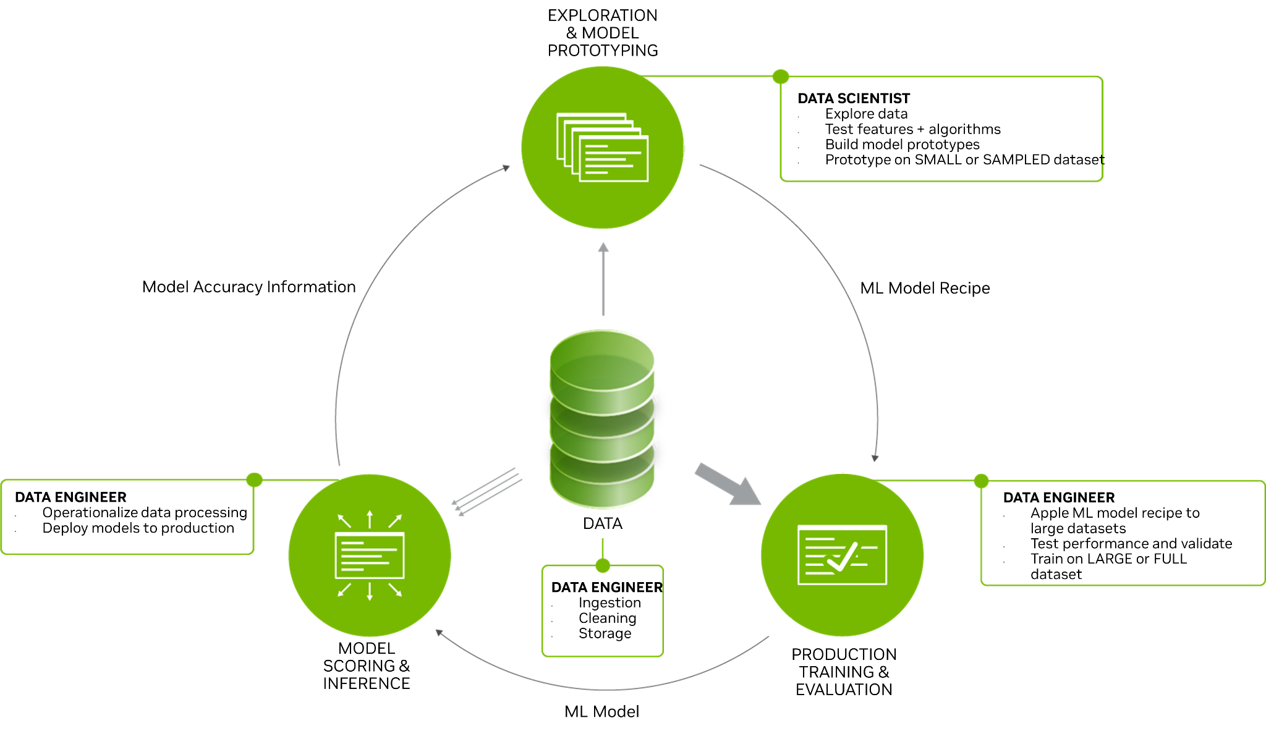
Data Flywheel
Improve performance through the cyclical nature of data-driven growth and innovation

Slide 36
Hands-On Lab

